Slide 1
Quick Recap

Slide 2
Data-Types
Sampling
Explantory Variable → Response
Mean Median Mode, Variance, Standard Deviation
Scatter plot , Dot Plot, Histogram
Box Plot

Slide 3
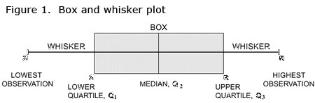
Box Plot
Graph that presents information from a five-number summary.
It does not show a distribution in as much detail as a stem and leaf plot or histogram does, but is especially useful for indicating whether a distribution is skewed and whether there are potential unusual observations (outliers) in the data set. Box and whisker plots are also very useful when large numbers of observations are involved and when two or more data sets are being compared.

Slide 4
A year ago, Angela began working at a computer store. Her supervisor asked her to keep a record of the number of sales she made each month.
The following data set is a list of her sales for the last 12 months:
34, 47, 1, 15, 57, 24, 20, 11, 19, 50, 28, 37.
Use Angela's sales records to find:
the median
the range
the upper and lower quartiles
the interquartile range

Slide 5
The values in ascending order are: 1, 11, 15, 19, 20, 24, 28, 34, 37, 47, 50, 57. Median = (12th + first) ÷ 2 = 6.5th value = (sixth + seventh observations) ÷ 2 = (24 + 28) ÷ 2 = 26

Slide 6
The values in ascending order are: 1, 11, 15, 19, 20, 24, 28, 34, 37, 47, 50, 57. Median = (12th + first) ÷ 2 = 6.5th value = (sixth + seventh observations) ÷ 2 = (24 + 28) ÷ 2 = 26

Slide 7
Lower quartile = value of middle of first half of data Q₁ = the median of 1, 11, 15, 19, 20, 24 = (third + fourth observations) ÷ 2 = (15 + 19) ÷ 2 = 17

Slide 8
Upper quartile = value of middle of second half of data Q₃ = the median of 28, 34, 37, 47, 50, 57 = (third + fourth observations) ÷ 2 = (37 + 47) ÷ 2 = 42

Slide 9
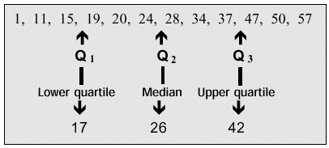
Interquartile range = Q₃–Q₁ = 42 – 17 = 25

Slide 10
Like Angela, Carl works at a computer store. He also recorded the number of sales he made each month. In the past 12 months, he sold the following numbers of computers:
51, 17, 25, 39, 7, 49, 62, 41, 20, 6, 43, 13.
Give a five-number summary of Carl's and Angela's sales.
Make two box and whisker plots, one for Angela's sales and one for Carl's.
Briefly describe the comparisons between their sales.

Slide 11
First, put the data in ascending order. Then find the median. 6, 7, 13, 17, 20, 25, 39, 41, 43, 49, 51, 62. Median = (12th + 1st) ÷ 2 = 6.5th value = (sixth + seventh observations) ÷ 2 = (25 + 39) ÷ 2 = 32 There are six numbers below the median, namely: 6, 7, 13, 17, 20, 25. Q1 = the median of these six items = (6 + 1 ) ÷ 2= 3.5th value = (third + fourth observations) ÷ 2 = (13 + 17) ÷ 2 = 15 Here are six numbers above the median, namely: 39, 41, 43, 49, 51, 62. Q₃ = the median of these six items = (6 + 1) ÷ 2= 3.5th value = (third + fourth observations) ÷ 2 = 46

Slide 12
The five-number summary for Carl's sales is 6, 15, 32, 46, 62. Using the same calculations, we can determine that the five-number summary for Angela is 1, 17, 26, 42, 57.

Slide 13
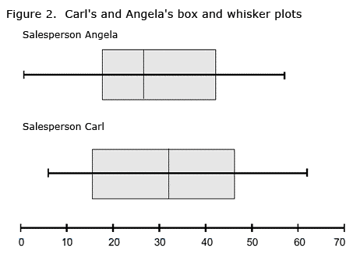
Carl's highest and lowest sales are both higher than Angela's corresponding sales, and Carl's median sales figure is higher than Angela's. Also, Carl's interquartile range is larger than Angela's. These results suggest that Carl consistently sells more computers than Angela does.

